Slide 1
Probing the World for Groove:
A comparative study of Transfer Learning for Drum audio Style Classification
Trent Eriksen (s3746887) | MSc. Media Technology Thesis Defense
Notes:
guidelines for presentation: https://www.universiteitleiden.nl/media-technology/for-students/graduation-presentation

Slide 2
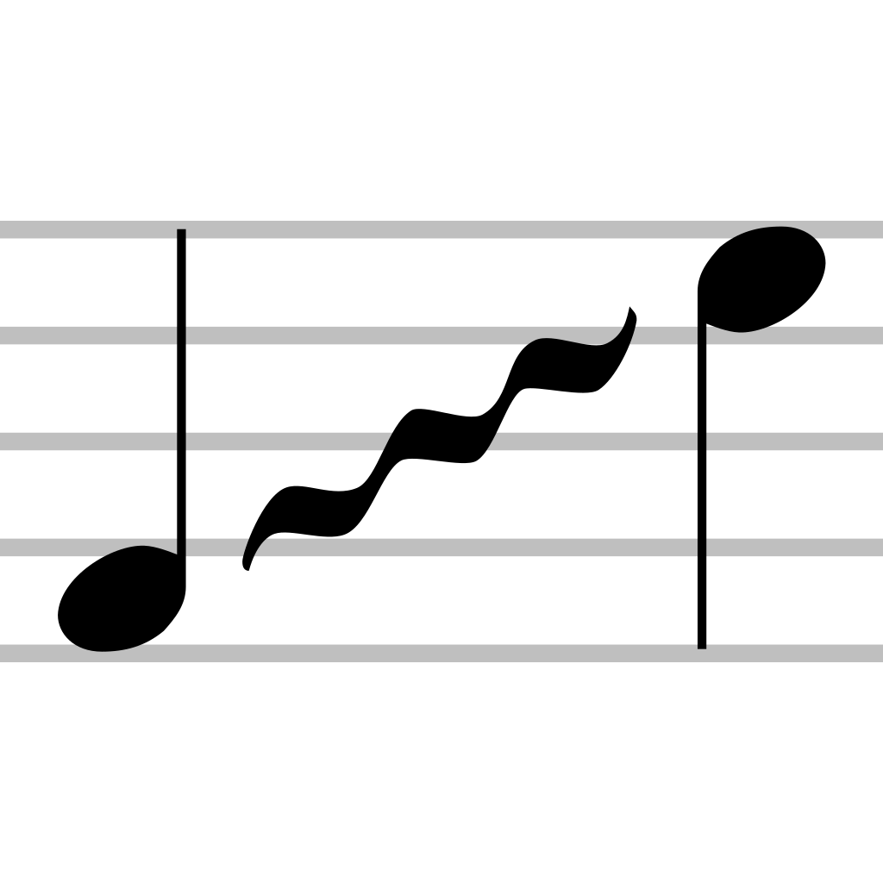
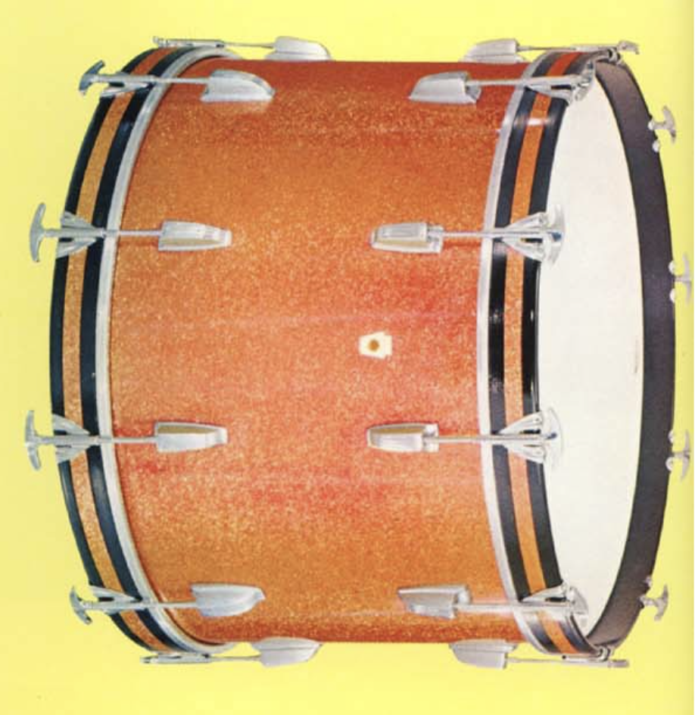
Outline
Introduction
Related Work
Methodology
Experiments
Results
Analysis & Discussion
Conclusion & Future Research

Slide 3

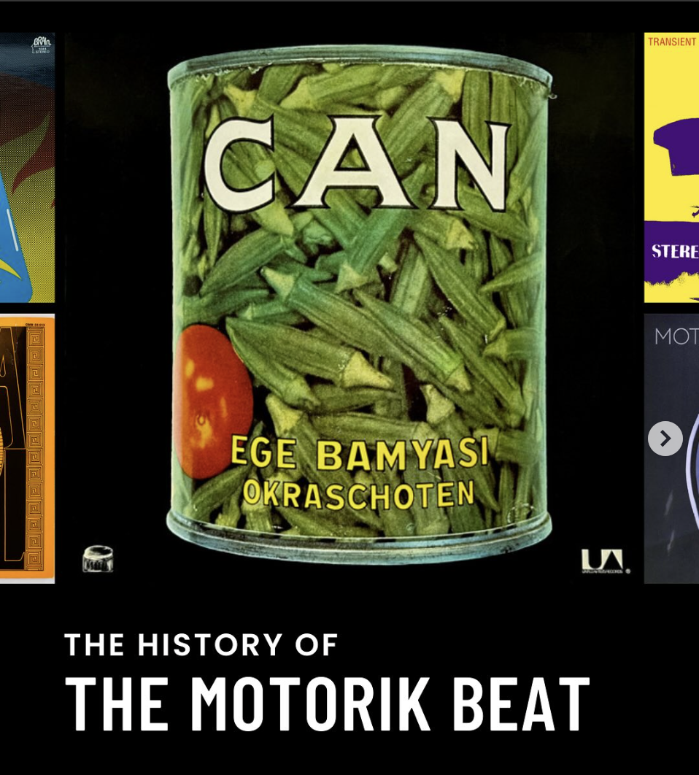
Inspiration and Background
Original inspiration: Detection of the "motorik" drum pattern from 1970s German rock.
Challenges: dataset creation, source separation, annotation complexity.
Shifted research scope to focus on existing dataset: Groove MIDI Dataset (GMD) and classify style.
Transfer learning shown as a fruitful approach in other MIR (Music Information Retrieval) Research but is understudied for drum audio style.
Notes:
Inspiration explains the “why”
Drum audio styles are patterns over time grouped by a semantic label (for example, funk, jazz, latin etc.)
very steady 4/4 beat (audio clip?)
to separate this from music you need polyphonic audio stem separation, beat tracking algorithms, audio clip regularization
Through searching for data sets we found the GMD that already had rich metadata
Transfer Learning -
The research broadly fits into MIR

Slide 4
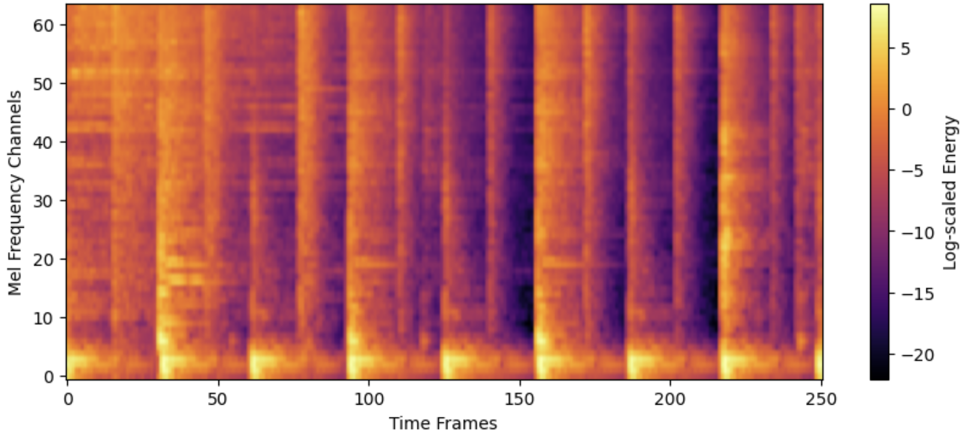
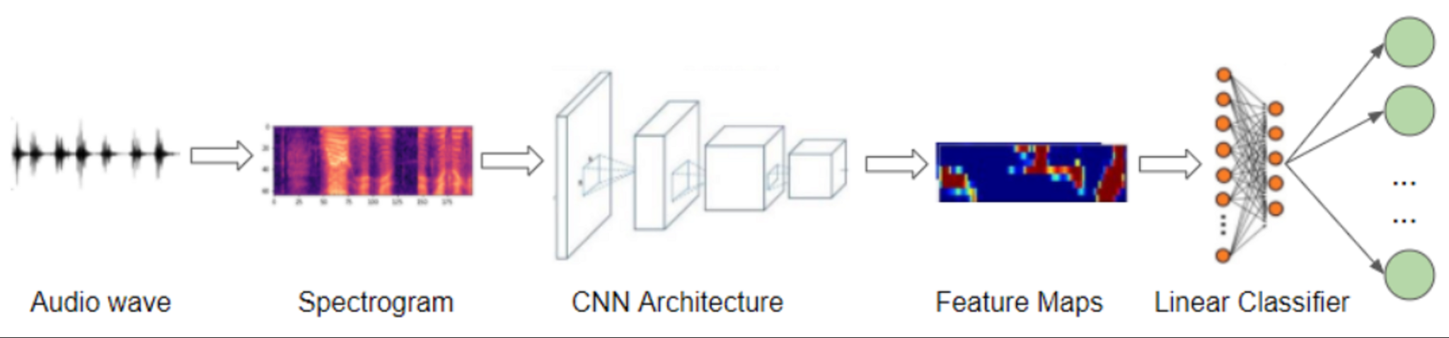
Related Work: Polyphonic Audio Classification
Audio to Spectrograms via STFT (Short-time Fourier Transform) segmented into frames for classifying and aggregating predictions.
CNNs have been shown successful for music classification focusing on local features (Choi 2016).
Transformers (Vaswani et al. 2017) have been utilized to focus on more global rather than local features and can be more useful for variable length audio
Audio Spectrogram Transformer (AST) uses self-attention for global temporal dependencies.(Gong 2021). PaSST (Patchout Audio Spectrogram Transformer) is adapted from AST with patchout to remove sections of spectrogram.
Notes:
CNNs use convolutional layers to extract local features
Transformers use self attention mechanisms to weigh different parts of the input making it more focused on global features
mention GTZAN? need to cite specific authors. Pretrained audio embeddings (VGGish, OpenL3) exploit YouTube datasets. ?
The global features is a good point to bring up when comparing primary styles discussion later.
These kinds of architectures are often used for for example with music genre classification making them useful for our task

Slide 5
Related Work: Single Instrument Classification
CNNs demonstrated efficacy on small-medium size datasets (Yun 2018).
Models made to classify individual drum instruments like snare, kick, hi-hat etc. within large scale datasets (Hiner 2023).
Performs well for timbral distinction in shorter audio lengths with limited utility of temporal information.
Notes:
The goal could be to Classify isolated drum hits (snare, kick, cymbal).
need to cite specific authors, pull in info from thesis document. Maybe remove this slide?

Slide 6
Related Work: Transfer Learning
Popular ML technique utilizes a model trained on a source task for a target task.
Especially useful if target tasks are data scarce.
Source = AudioSet classification , Target = GMD style classification
The source results in pretrained embeddings that can then be used as feature extractors.
Shown to achieve state of the art results on AST based systems(Quelennec 2023).
Notes:
Source task is often defined as the dataset
Instead of training a model from scratch, it leverages the knowledge gained from a previous task to accelerate learning and improve performance on the new task, especially when data for the new task is limited
OpenMIC (musical instruments), TAU Urban Acoustic Scenes 2020 Mobile, and ESC-50 (environmental sound).
Removed content on ADT:
Limited insight into temporal patterns forming drum styles.
Symbolic automatic drum transcription (ADT) relies on MIDI files, losing timbral details.
Audio-based style classification retains critical timbral nuances lost in MIDI
Currently underexplored, particularly comparing CNNs with pretrained transformers on isolated drum audio

Slide 7
Research Context
Most drum related research focuses on symbolic representations or single instrument classification.
Existing audio classification studies utilize CNNs (Convolutional Neural Networks) effectively for single-instrument audio.
Transformer-based models like have shown improvements in other audio classification tasks when pretrained with AudioSet.
Challenge: Assess the relationship between general audio embeddings and classifying drum audio styles.
Notes:
symbolic can be standard sheet music like notation or MIDI for example
other classification tasks? like Environmental sound classification, speech recognition and musical instrument recognition

Slide 8
Research Question
"What is the effect of pretrained general audio embeddings in PaSST when compared to a baseline CNN for drum audio style classification?"
CNN baseline trained only on GMD.
PaSST Transformer pretrained with AudioSet with frozen embeddings.
Evaluation focus: classification accuracy and latent feature representation differences.

Slide 9
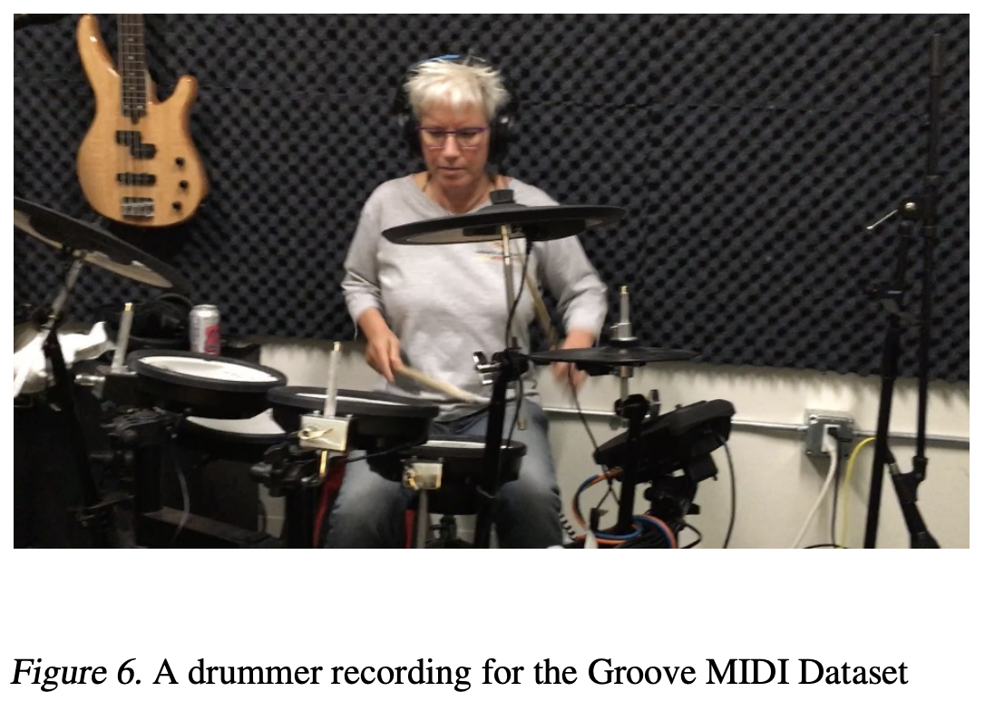
Methodology – Groove MIDI Dataset (GMD)
GMD contains over 18,000 drum audio files labeled and performed by professional drummers.
Files segmented into two measures irrespective of tempo (BPM).
Annotations include primary and secondary styles concatenated into single labels for simplified classification while still preserving hierarchical relationships.
All audio in 16 kHz, padded uniformly to 10-second fixed length to match comparisons between architectures.
Notes:
Modest size dataset
segmentation results in variable length (this motivates padding)
Play drum audio sample here?
highlight GMD hierarchical annotations (primary style, secondary style, BPM, time signature, beat type)

Slide 10
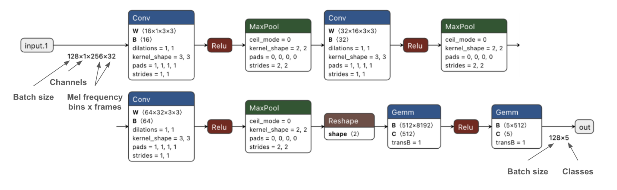
Methodology – CNN Baseline Architecture
CNN adapted from drum classifier model based on VGG (Hiner 2023).
Optimized from Three to Seven Conv2D layers, max pooling, dropout, and global average pooling. Two fully-connected layers (512 dimensions), final dense output layer for class probabilities.
Trained for with Adam optimizer, batch size 16, learning rate 1e-4 for 50 epochs with early stopping at 10 epochs.
Notes:
VGG- Visual Geometry group

Slide 11
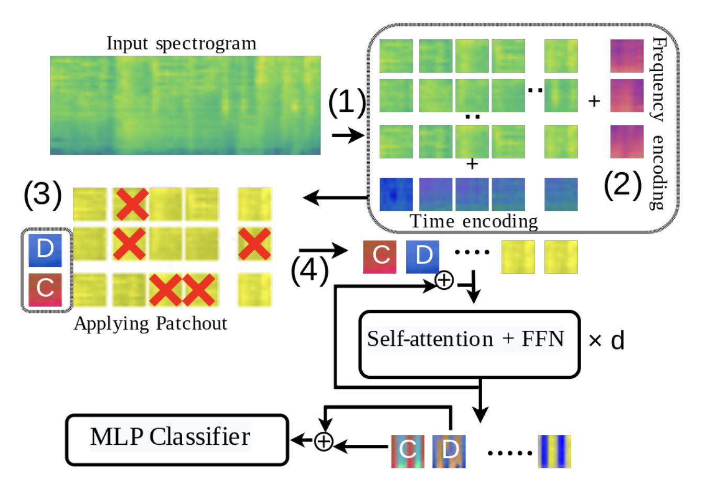
Methodology – PaSST Pretrained Transformer
PaSST: pretrained on AudioSet dataset (~1 million diverse audio clips). Developed by Koutini et al. 2022 adapted from AST.
Pretrained on 32 kHz audio, with disentangled time and frequency positional encodings.
PaSST-L version used after testing: lighter, 7-layer transformer (instead of 12 layers).
Embeddings frozen, MLP classification head optimized.
Trained for 50 epochs with 10 patience early stopping.
Notes:
mention of the 768 dimensional embedding?
more training details?
Authors provided many different pretrained configurations
MLP - Multilayer Perceptron - need to explain this as the classification head?
We take the MLP classifier and adopt in in later experiments.

Slide 12
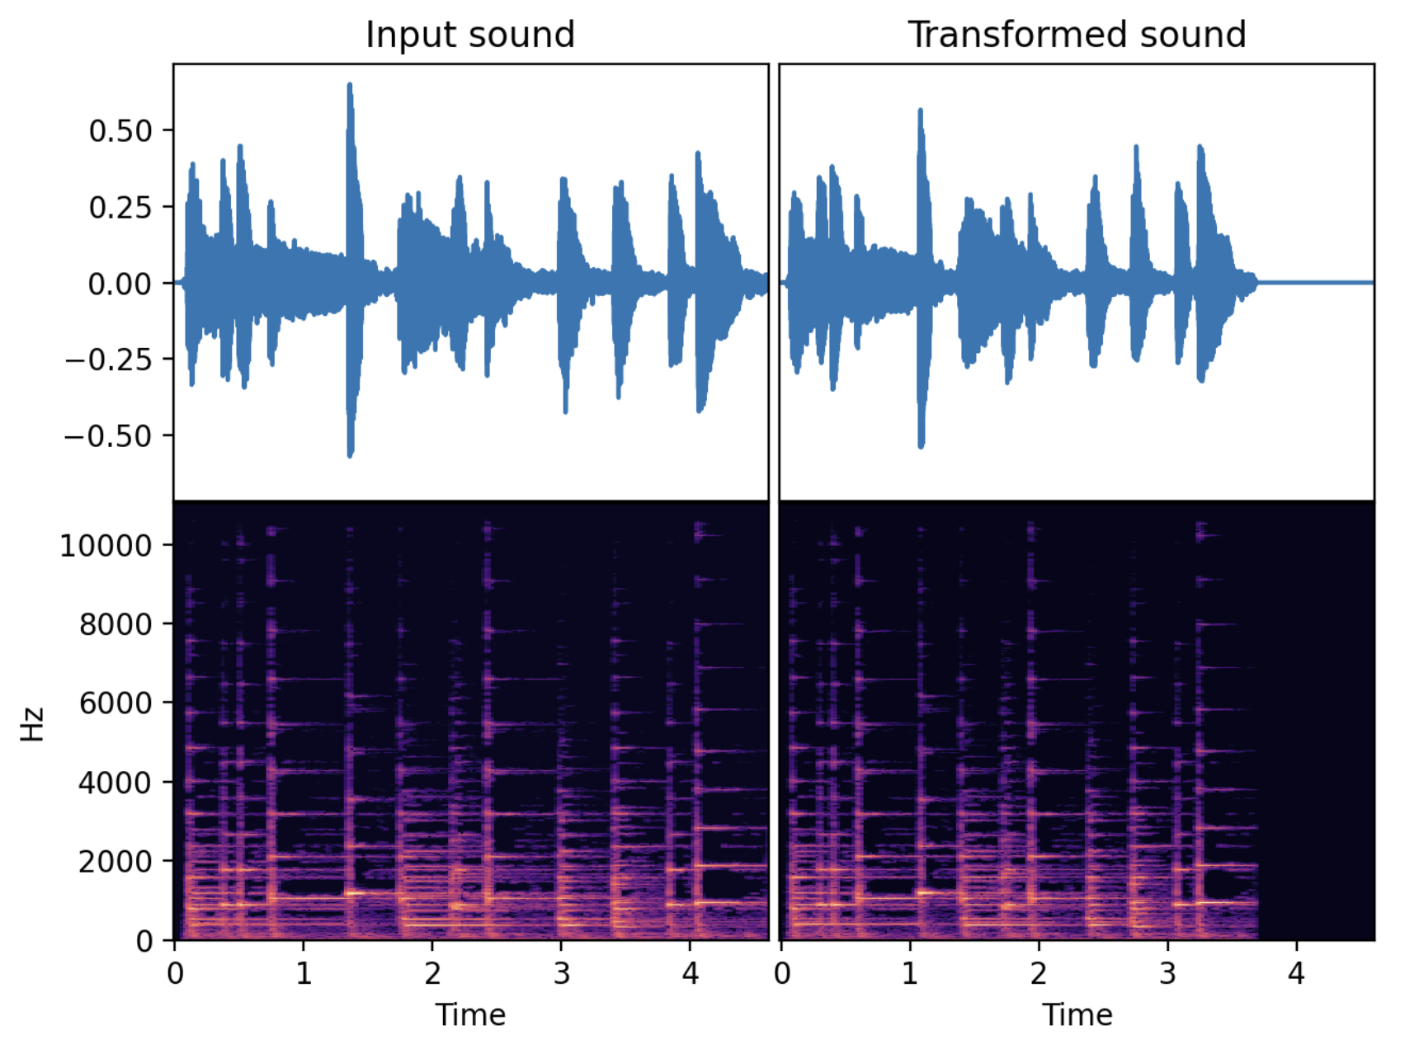
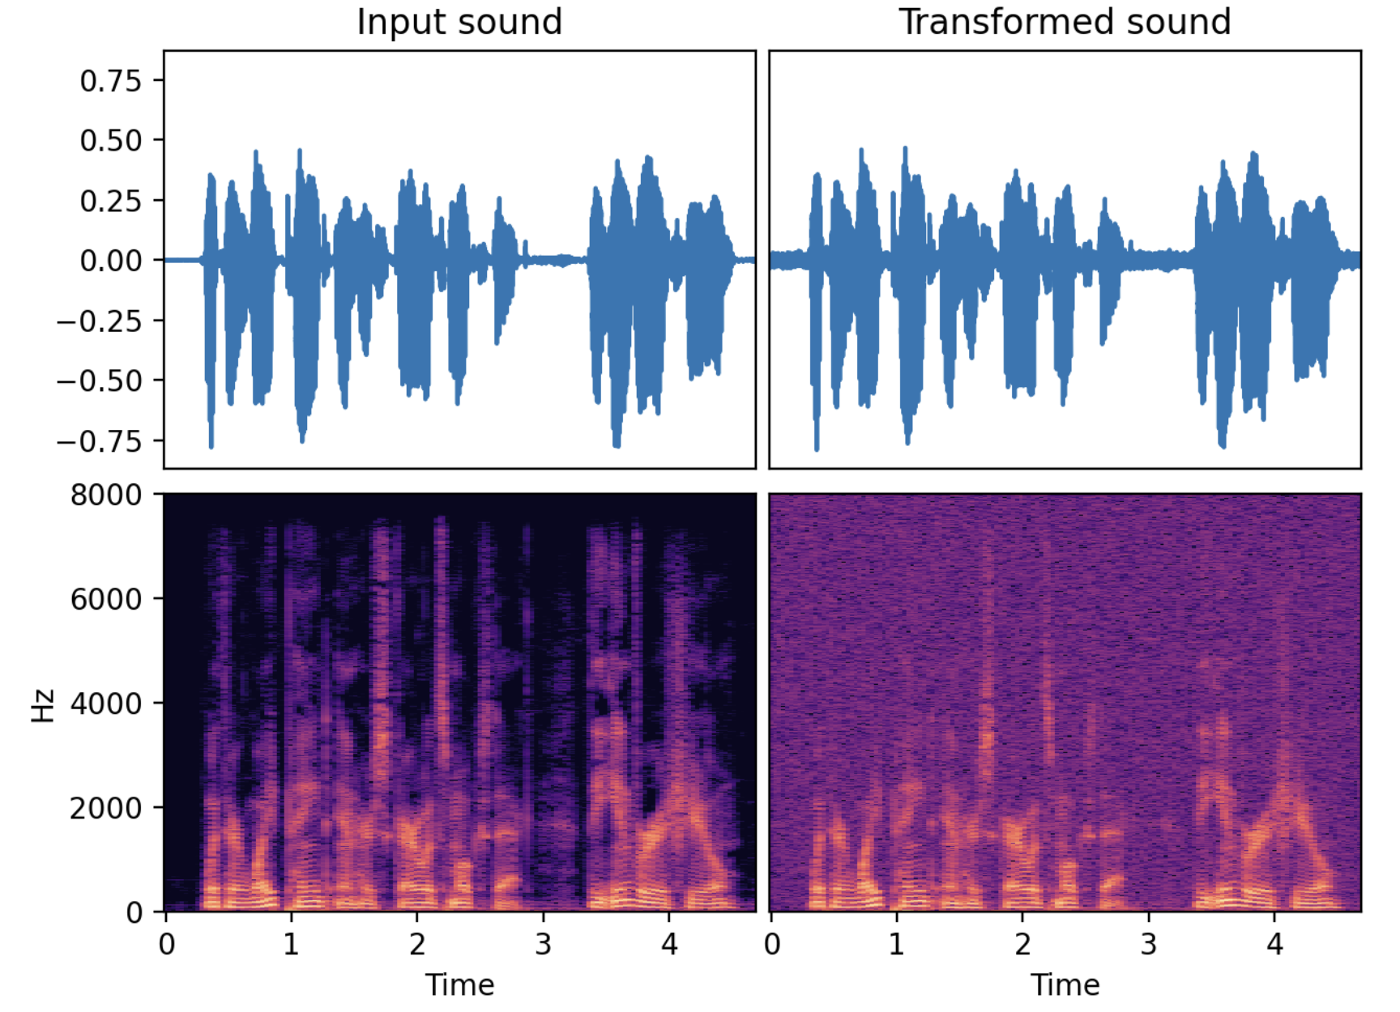
Methodology – Data Augmentation and Padding
Focus: observe embedding shifts and feature robustness.
Gaussian Noise, Room Simulation, Time Stretch, Time patchout.
Padding modes tested: Zero-padding, Circular-padding, Reflection-padding.
Waveform and spectrogram based augmentations tested.
Notes:
although importantly, patchout is spectrogram based and only applied to the transformer
embedding shift explained later
audio examples of what these augmentations are? - time stretch pictured abovem speeds up the file , gaussian noise pictured bottom
Speectrogram picture earlier? (take from one of the notebooks?
Audio demonstration of these augmentations?
Audiomentations library used

Slide 13
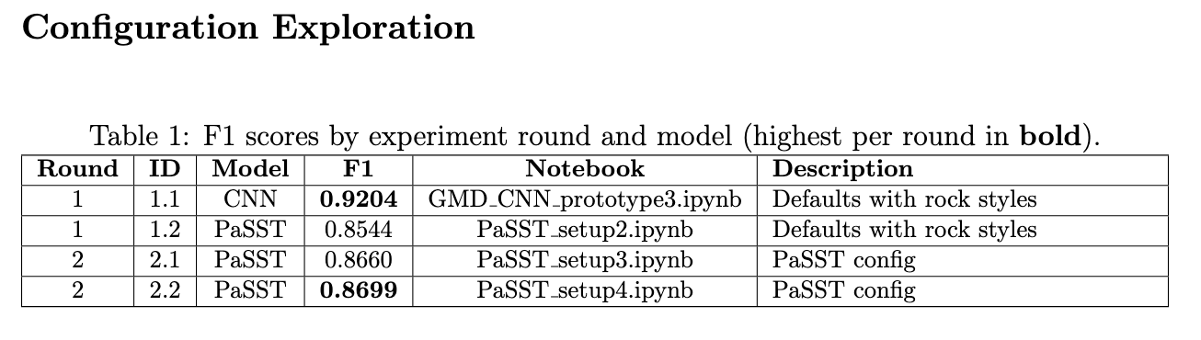
Experiments – Configuration Exploration
Initial dataset: 5082 rock style audio files from GMD subset (4/4, 120BPM).
CNN achieved initial accuracy of 92.04%, PaSST lower at 86.99%.
Optimal PaSST configuration Experiment 2.2: PaSST-L (light model) highest accuracy and fastest training.
Notes:
first round only on rock primary and secondary. Note this is almost ⅓ of the dataset - we will revisit the class imbalance issue later

Slide 14
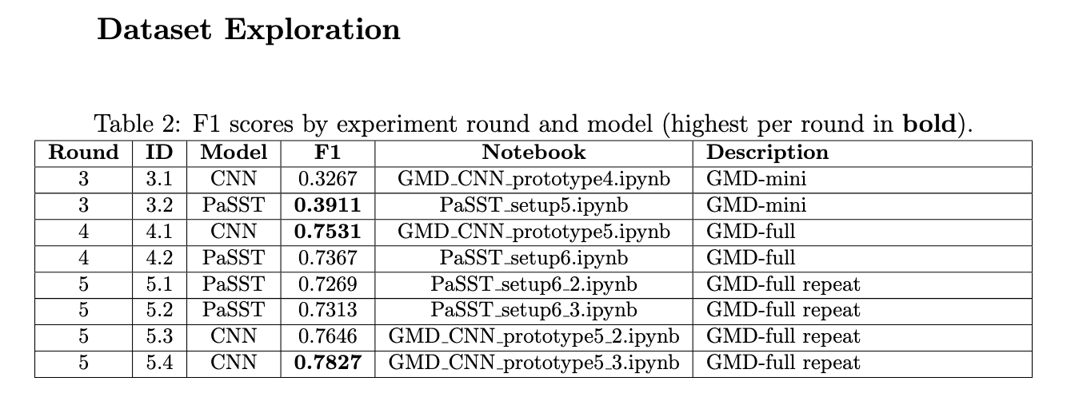
Experiments – Dataset Exploration
Expanded dataset tests: CNN (75.31%), PaSST (73.67%) using entire GMD.
PaSST accuracy improved on smaller datasets (mini-GMD subset) surpassing CNN marginally (39.11% vs. 32.67%).
CNN outperforms PaSST in terms of accuracy.
Notes:
Four Groups of 11 rounds of experiments
GMD mini was a balance proxy of the full dataset accounting for all classes in all splits
Good to comment here the gap between the models is small

Slide 15
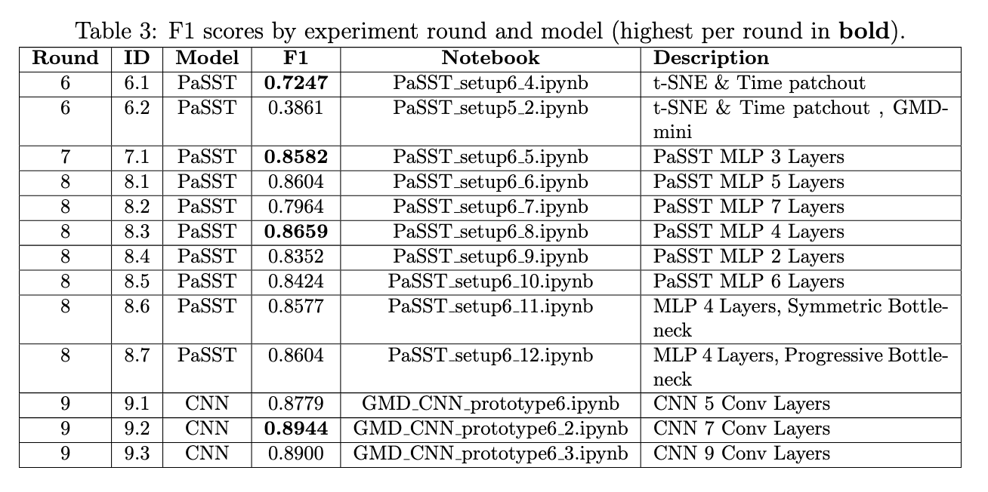
Experiments – Model Depth and Patchout
CNN optimal convolutional depth: 7 layers (89.44% accuracy).
PaSST optimal classifier head: 4-layer MLP, accuracy improved substantially (86.59%).
Excessive layers (CNN 9-layers, PaSST 7-layer MLP) decreased accuracy.
Bottlenecked MLP did not enhance PaSST accuracy.
Notes:
Four Groups of 11 rounds of experiments
briefly mention what t-SNE is and that it is used to visualize embeddings
explain the multilayer perception (MLP) is the classification head placed
Bottleneck compresses features and reduces trainable parameter count

Slide 16
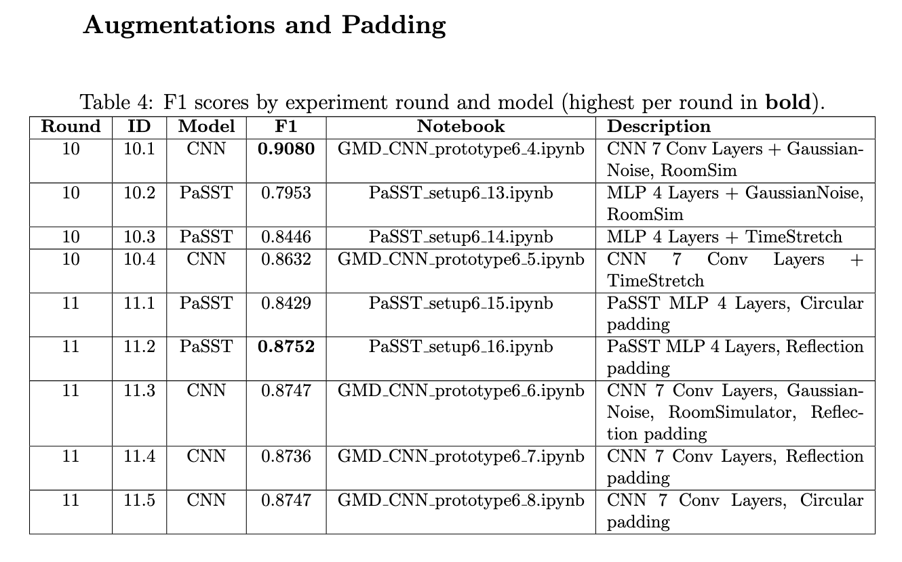
Experiments – Augmentations and Padding
CNN best result: Gaussian Noise + Room Simulator (90.80% accuracy).
PaSST best result: Reflection padding (87.52% accuracy).
Augmentations improved CNN accuracy and revealed PaSST robust feature representation.
CNN negatively affected by non-zero padding (reflection, circular padding), while PaSST improved.
Notes:
We do these experiments to observe embedding shift - which helps to elucidate some of the later conclusions.
we also began at this point to implement t-SNE t distributed stochastic neighbor embedding do visualize the embeddings.
Four Groups of 11 rounds of experiments
audio example of what augmentation sounds like?
Gaussian, Noise, Room Simulator, Timestrech
Briefly explain variable length and padding modes (Zeros, Reflection, Circular)

Slide 17
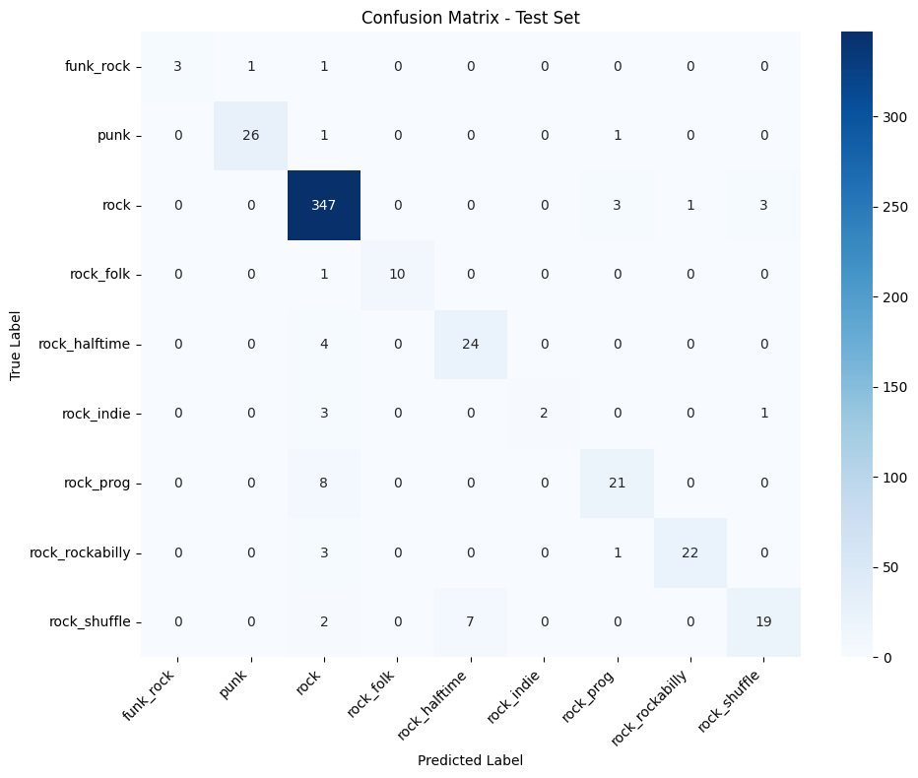
Confusion Matrix Analysis – CNN vs. PaSST
Shared difficulty: Jazz , Latin, Funk styles.
Augmentations revealed potentially primary style based misclassifications (PaSST)
CNN misclassification skewed towards class imbalance.
Notes:
Prototype confusion matrix shown, the actual ones are too large with 74 classes
classifying jazz-fast and latin-brazilian-bossa consistently confused across experiments.
(CNN: jazz-fast confused with dance-breakbeat, PaSST: funk confused with jazz styles).

Slide 18
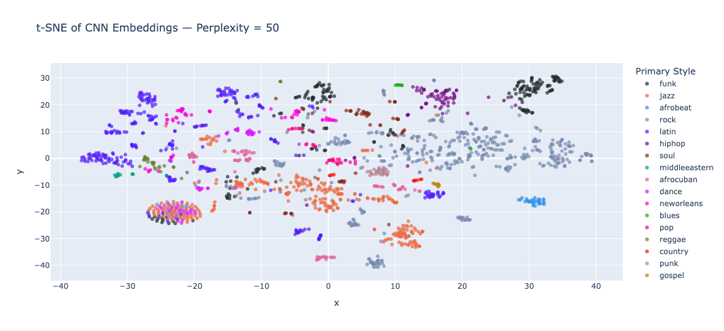
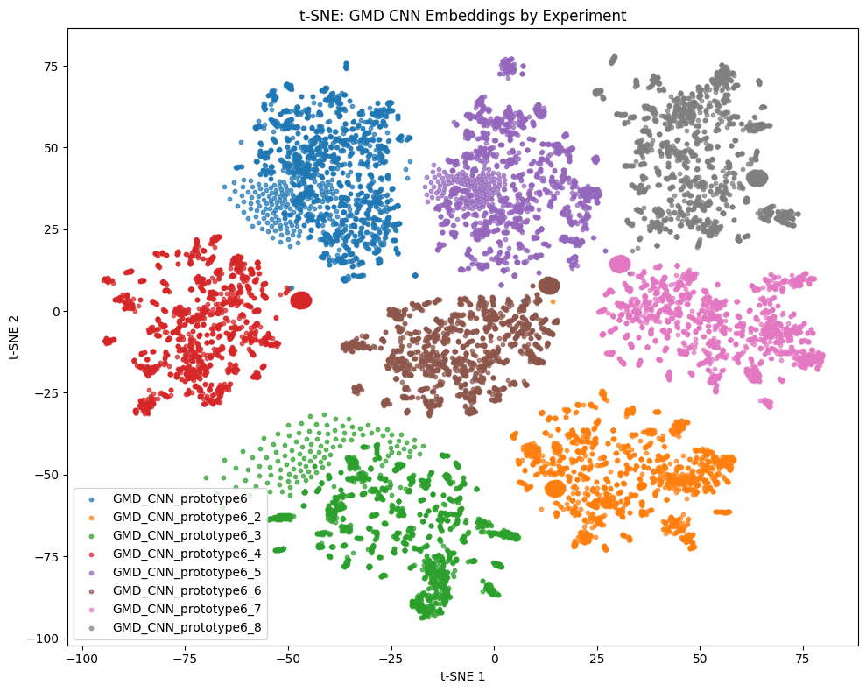
Embedding Analysis – CNN
“Mini clusters” form per style class while clusters sprawl by primary style.
Some examples formed distinct anomalous cluster.
~10x mean centroid shift compared to PaSST (esp. with reflection vs. zero-padding).
High sensitivity to audio perturbations, distinct changes in embeddings observed clearly.
Mean centroid shift did not coincide with changes in accuracy.
Notes:
Crucial slide - joke about Jackson Pollock trying to be a pointillist. (Is this a Georges Seaurat Painting?)
The top is grouped by primary stye showing mini clusters - shows the importance of having the hierarchical style annotation
bulb could be related to many aspects of the files but we dont know for sure (BPM, beat/fill, length,
mean centroid shift - measures how much the center of the cluster moves (this was evalued both by primary and style-class)
Note the bottom figure shows different experiments
Different trends in shift did not coincide between shifts in accuracy

Slide 19
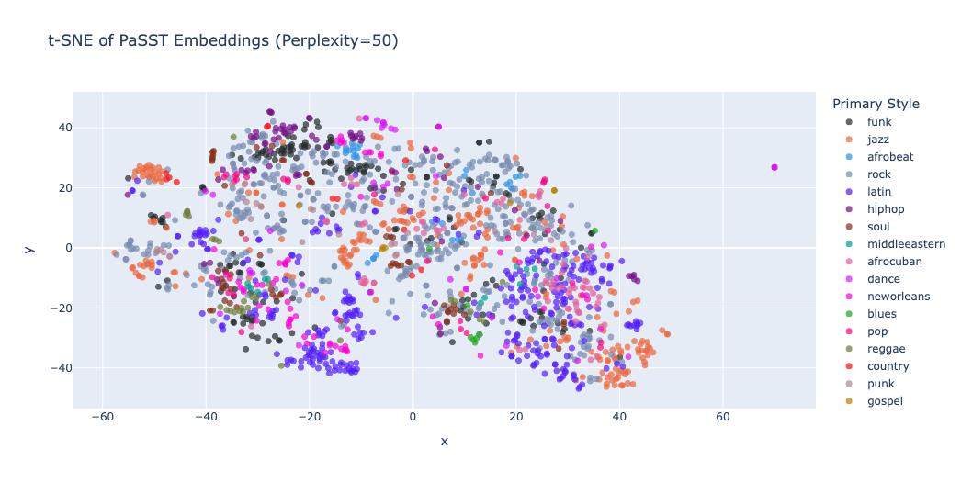
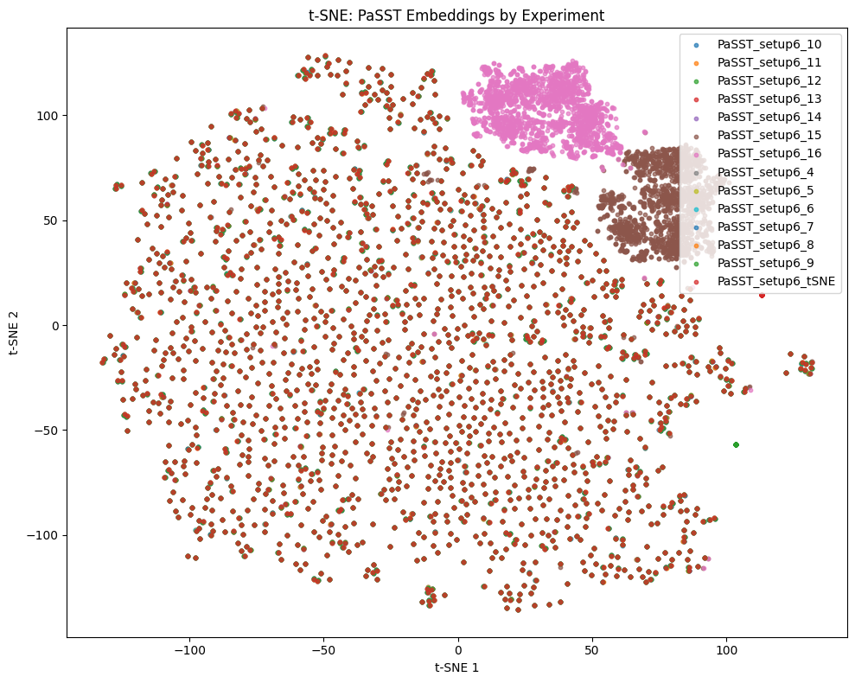
Embedding Analysis – PaSST
Clustering by primary styles more broadly observed rather than by individual style class.
Embedding shifts minimal except notable shifts during padding mode changes (reflection highest shift similar to CNN).
Lower mean centroid shift co-occurs with higher accuracy in many cases.
PaSST appears more fortified against experimental changes and which demonstrates a robust feature representation.
Notes:
Bottom image shows very little embedding shift until padding modes were changed
The embeddings move less as they are fortified with audioset embeddings
more detail about mean centroid shift and accuracy?
Still achieves 87.5% accuracy

Slide 20
Discussion
CNN outperformed PaSST in accuracy consistently in terms of accuracy, benefiting from GMD only training but was more reliant on local features.
PaSST's general audio embeddings shift less and are more grouped by primary style, hinting that the embeddings play a role in the fundamental underlying feature representation despite marginally lower accuracy.
PaSST may have benefited more from additional compute as accuracy was still marginally increase at the epoch max
Notes:
Four Groups of 11 rounds of experiments

Slide 21
Limitations
Dataset heavily imbalanced toward "rock" style (approximately 65% of the dataset).
Subjectivity and potential lack of nuance in GMD annotations by human experts.
No use of MIDI data in GMD.
Compute resource limitations constrained extensive hyperparameter optimization and experimentation.
Notes:
These arent all limitations but the main ones:
Lack of exploration of fine tuning strategies.
No exploration of MIDI integration or polyphonic music context.
PaSST was more feasible to implement but may have not be been the best architecture to compare

Slide 22
Future Research
Incorporate Expanded GMD (E-GMD) with larger dataset, diverse drum timbres.
Combine with other pipelines into ensemble models to enhance generalizability beyond supervised learning contexts.
Notes:
Extend to polyphonic musical audio, employing source separation and automated annotation

Slide 23
Conclusion
First known comparative study between a baseline CNN and an AudioSet petrained transformer based model for drum audio style classification in the GMD.
General audio embeddings in a transformer architecture reduce accuracy compared to a baseline CNN but produced a more robust feature representation.
Waveform Augmentations were revealed differences in hierarchical clustering.
Padding mode changes created notable embedding mean centroid shift.
Notes:
Results contribute significant insights into transfer learning effectiveness in audio-based style classification.
These arent all limitations but the main ones:
No exploration of MIDI integration or polyphonic music context.
PaSST was more feasible to implement but may have not be been the best architecture to compare

Slide 24
Thank you! Questions?
Thank you!

